Slide 1

UNIT 2
(Artificial Intelligence & Machine Learning)
Notes:
‹#›

Slide 2
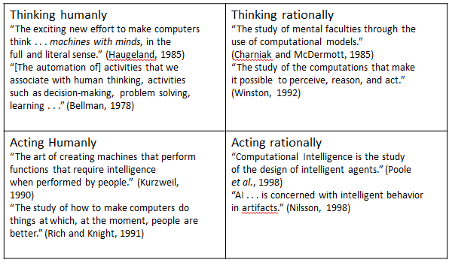
Introduction to AI
Notes:
‹#›

Slide 3
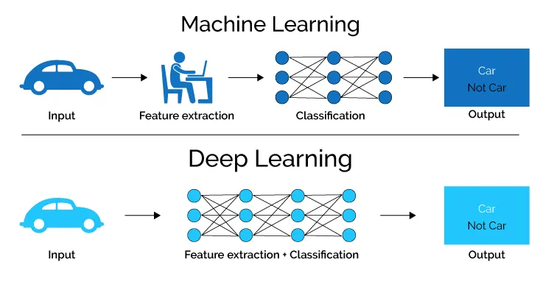
Machine Learning and Deep Learning

Slide 4
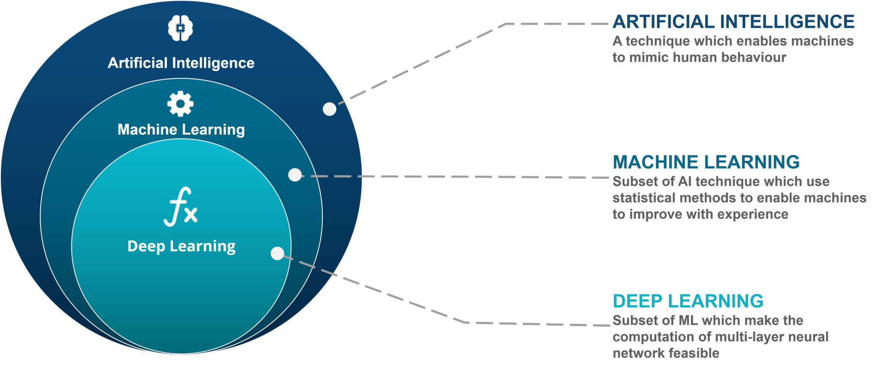

Slide 5
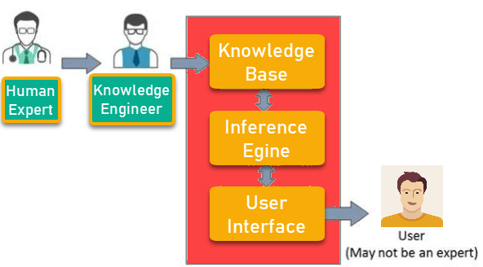
Expert Systems

Slide 6
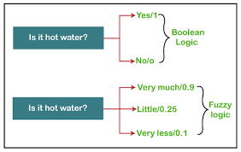
Fuzzy Logic

Slide 7
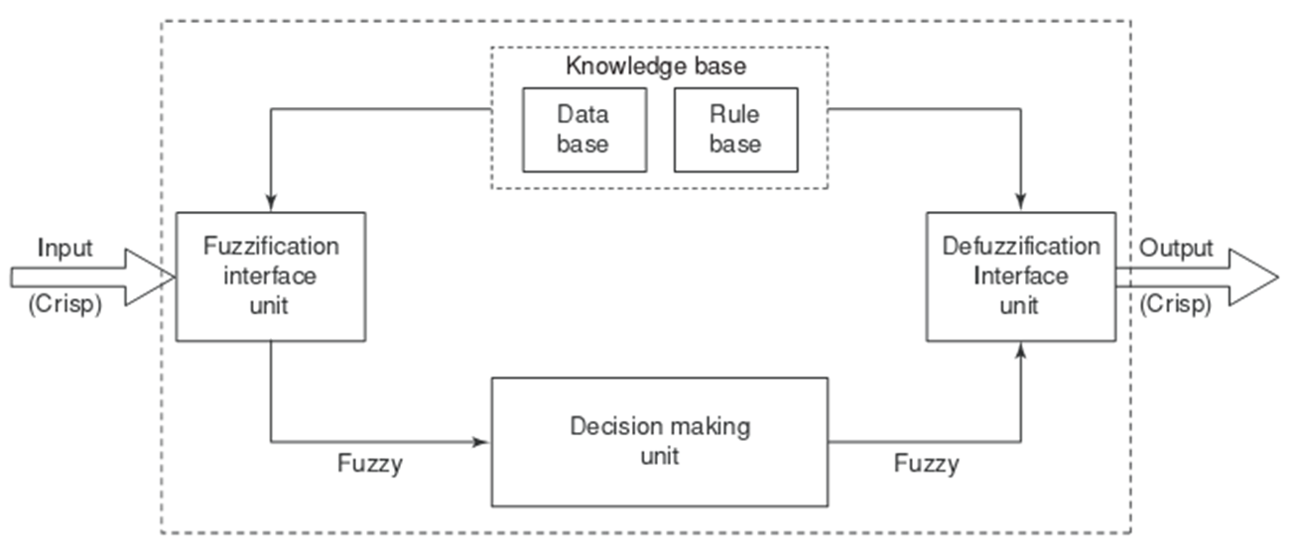
Fuzzy Inference System

Slide 8
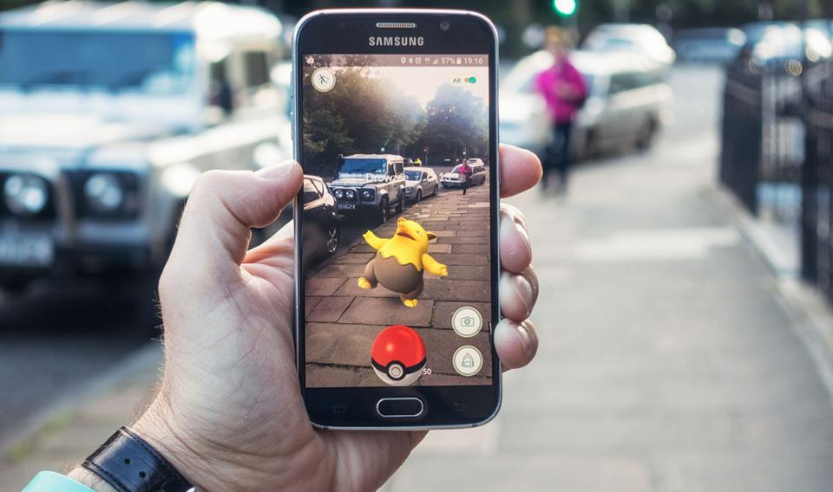
Augmented Reality
Augmented reality (AR) is the integration of digital information with the user's environment in real time.

Slide 9
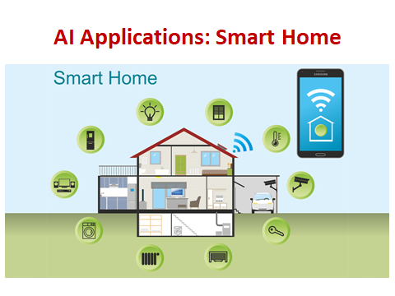
Notes:
‹#›

Slide 10
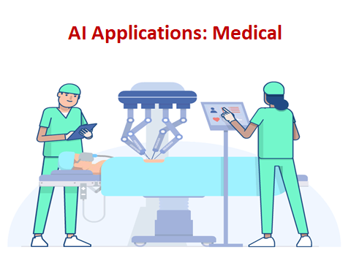

Slide 11
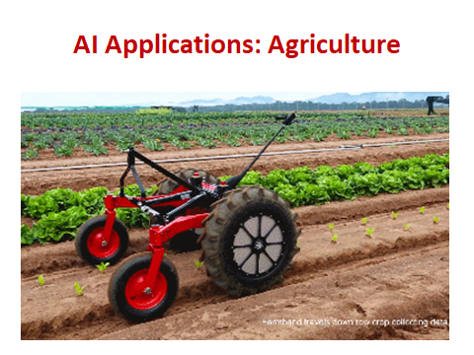

Slide 12
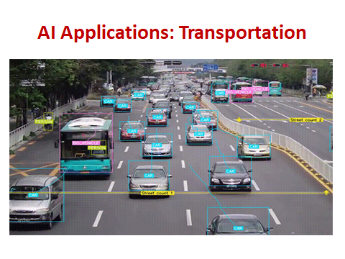

Slide 13
Tools and techniques
Scikit Learn
TensorFlow
PyTorch
CNTK
Caffe
Apache MXNet
Keras
OpenNN
AutoML
H2O
Notes:
‹#›

Slide 14
Current trends and opportunities
Development in predictive analytics
Large Language Models (LLM)
Information security (InfoSec)
Launch of better autonomous systems
Art through NFTs
Digital avatars
Military weapons
healthcare
Notes:
‹#›

Slide 15
Job roles and skill set
SKill Set
Programming languages (Python, R, Java are the most necessary)
Linear algebra and statistics
Signal processing techniques
Neural network architectures
Job Roles
Machine Learning Engineer
Data scientist
Robotics scientist
Research
Notes:
‹#›

